Slide 1
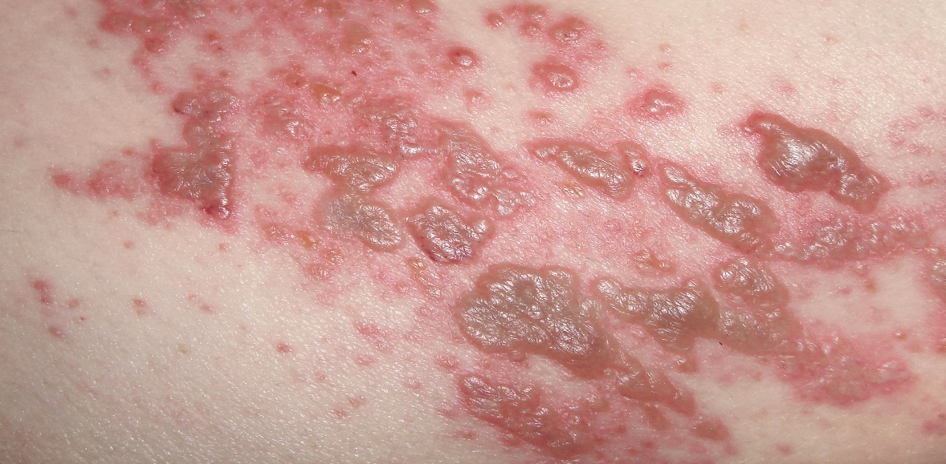
Rash in Pregnancy
Dr.Hajra Farooq
Resident Virology

Slide 3
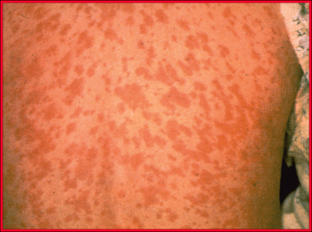
Maculopapular Rash:
Macule means ‘spot’ and papule means ‘little bump’
Uniform, small, red spots on the skin which may feel slightly ‘bumpy’ to touch
Seen in:
Rubella (Pakistan)
Measles
Parvovius B19 (UK)
Enterovirus (Cosackevirus)
HHV-6 and 7

Slide 4
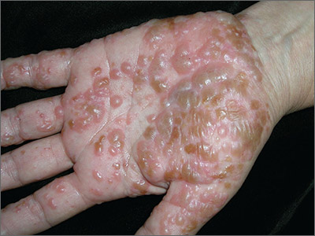
Vesicular Rash:
Small blisters
Raised and have fluid filled vesicles
Vesicular rashes are seen in:
Varicella Zoster Virus
Chickenpox – all over the body
Shingles (Herpes Zoster) – localised
Herpes simplex – localized to mouth or genital regions

Slide 5
A pregnant woman presenting with a rash illness:
Comprehensive clinical history and examination be taken for all pregnant women presenting with a rash
The appearance of the rash should be determined as vesicular or non-vesicular to plan
lab test and
management
If the nature of the rash is unclear they should be investigated for both vesicular and non-vesicular causes

Slide 6
Question 1:
A toddler develops fever with rash and his physician diagnoses him with a case of German Measles . His mother who is six week pregnant and becomes worried about developing fetus and visits you for advise. What would you advise?
A. Reassurance
B. Check her Rubella IgM Serology
C. Check Rubella IgG Avidity
D.PCR
E. All of the above

Slide 9
Answer:
C

Slide 10
Rubella:
If a woman is suspected of having rubella, the following points should be kept in mind
Gestational age
Date of rash onset
Other full clinical and epidemiological details

Slide 11
Implications for Pregnancy:
Infection in the mother is mild and self-limiting
The fetus is at risk of developing CRS
The risk of CRS is related to the timing of the primary maternal infection
Less than 10 weeks: 80 – 90% (Multiple Defects)
11 – 16 weeks: 10 – 20%
16 – 20 weeks: 20% (deafness)
Greater than 20 weeks: less than 1%

Slide 12
Laboratory Investigation of Rubella Infection:
A blood sample should be sent at presentation and compared with booking blood
Diagnosis cannot be made on the presence of a single positive IgM and should be confirmed either by demonstrating sero-conversion during pregnancy or with avidity testing (strength of binding of specific IgG)

Slide 13
Rubella:
IgG binding is weak if the sample is taken within a few weeks of a primary infection (low avidity) but matures over weeks/ months to become more strongly bound (high avidity) if the infection occurs six months or more before the sample was taken

Slide 14
Management of confirmed rubella infection:
There is no specific treatment for rubella
Management depends on the gestation of pregnancy, the individual circumstances of the woman and the likelihood of congenital abnormalities
Decisions on the management of a pregnant woman diagnosed with rubella in the first 20 weeks of pregnancy are best made in a specialist fetal medicine unit

Slide 15
Cont…
Because of the potentially devastating effects on the fetus, women should be counseled about maternal-fetal transmission and offered pregnancy termination, especially prior to 16 weeks’ gestation
After 20 weeks’ gestation, management should be individualized, and parents should be counseled about the potential for delayed consequences of rubella infection
There is no definitively beneficial in utero treatment available for exposed or affected fetuses

Slide 16
Management of the neonate:
Neonates should be investigated at birth for congenital infection preferably within the first month of life
Samples of cord blood, placenta, urine and an oral fluid should be taken from the infant soon after delivery
Congenital rubella infection (CRI) is confirmed by detection of rubella IgM in serum or oral fluid and/or detection of rubella RNA in body fluids

Slide 17
Cont…
Infants with congenital rubella infection are infectious
They excrete virus at birth and some may continue to excrete for more than a year
For infants diagnosed with CRI, isolation of infant until the infant in no longer considered infectious
Susceptible individuals should avoid contact with the infant and offered vaccination

Slide 18
Question:
A previously well 25 week pregnant school teacher presents after having contact with her 5 year old student 2 days ago who has generalized and pruritic vesicular rash. The lesions are mostly concentrated on the chest and back of the child. What would you advise?
a) Check her VZV serology
b) Zoster immunoglobulin if negative serology
c) Prophylctic aciclovir if negative serology
d) HHV 6 and 7 Serology
e) Measles IgM

Slide 20
Answer:
A

Slide 21
Generalized vesicular rash illness in pregnancy:
Investigation will be directed by clinical/epidemiological information
A disseminated vesicular rash is highly suggestive of chickenpox

Slide 22
Implications for Pregnancy:
Most cases of congenital varicella syndrome occur in infants whose mothers were infected between 8 and 20 weeks gestation
However, the overall risk of vertical transmission is quite small compared with other viruses acquired during pregnancy
The risk appears to be approximately
2 percent - if the infection occurs between 13 and 20 weeks
<1 percent - if it occurs before 13 weeks

Slide 23
Laboratory investigation of suspected chickenpox:
The diagnosis can be made clinically in many instances
Laboratory diagnosis of active infection should be by DNA detection, virus antigen or electron microscopy of vesicle fluid
Detection of VZV DNA in the amniotic fluid by polymerase chain reaction (PCR) can also be used for the confirmation of chickenpox infection in the fetus
This should only be requested by a specialist in fetal medicine and is usually requested in tandem with serial ultrasound scanning

Slide 24
Management of confirmed chickenpox infection in a pregnant woman:
All pregnant women require an urgent clinical assessment on presentation
They should avoid contact with others who might be at risk, such as other pregnant women and neonates, and the immunosuppressed

Slide 25
Uncomplicated varicella infection:
Oral acyclovir therapy (800 mg five times per day for seven days) for all pregnant women with uncomplicated varicella
( within 24 hrs of onset of Rash)

Slide 26
Cont…
If the chickenpox is uncomplicated, the woman can be reassured, offered acyclovir if appropriate and sent home with arrangements for daily review and for outpatient follow up for the fetus
The woman should be advised to seek help if the clinical picture deteriorates
If there is deterioration, or the fever persists, or the cropping of the rash continues after 6 days, or the woman develops respiratory symptoms, the woman should be referred for urgent hospital assessment

Slide 27
Cont…
The criteria indicating that hospitalization is required are:
respiratory symptoms
neurological symptoms other than headache
hemorrhagic rash or bleeding
severe disease – dense rash/numerous mucosal lesions
significant immunosuppression

Slide 28
Cont…
If the woman presents more than 24 hours from the onset of rash and there are no indications of complications, antivirals are not routinely advised
VZIG has no place in treatment once the rash appears
Intravenous treatment with aciclovir is indicated if the chickenpox is severe or there are any complications

Slide 29
Varicella pneumonia:
Intravenous acyclovir (10 mg/kg every eight hours) for pregnant women with varicella pneumonia

Slide 30
Management of proven chickenpox exposure in utero:
There is a lack of evidence to support immunoglobulin and aciclovir treatment to prevent vertical transmission or fetal varicella syndrome
In utero zoster

Slide 31
Management of the neonate exposed to chickenpox:
VZIG for neonates whose mothers develop chickenpox (but not shingles) in the period 7 days before to 7 days after delivery
VZIG can be given without VZV IgG antibody testing of the neonate or mother
Prophylactic, intravenous aciclovir should also be considered in addition to VZIG for neonates whose mothers develop chickenpox in the period 4 days before to 2 days after delivery, as they are at the highest risk of a fatal outcome despite VZIG prophylaxis

Slide 32
Cont…
If severe chickenpox develops in the neonate despite VZIG, high dose intravenous aciclovir treatment of 20mg/kg every 8 hours for at least 7 days should be started as soon as possible
Mothers with chickenpox or shingles can breast feed safely
If they have lesions close to the nipple, they should express milk from the affected breast until the lesions have crusted; this expressed milk can be fed to the baby

Slide 33
Question:
A 15 month old infant visited the GP clinic with history of fever, runny nose , rash and Koplik’s spots inside the buccal mucosa. The mother had not had any obvious illness during the pregnancy. What is your diagnosis?
A. Mumps
B.CMV
C. Measles
D. HBV
E. Rubella

Slide 35
Answer:
C

Slide 36
Implications for Pregnancy:
There is no evidence to support an association with congenital infection and fetal damage directly from measles infection
Maternal infection can be severe, which may result in fetal loss or preterm delivery
Congenital measles (defined by the appearance of measles rash within 10 days of birth) and postnatally acquired measles (defined as appearance of measles rash within 14 to 30 days of birth) are associated with a spectrum of illnesses ranging from mild to severe disease
Measles in 3rd Trimester

Slide 37
Laboratory investigation of suspected measles:
A serum sample should be collected at first presentation and sent for laboratory testing for measles-specific IgM and IgG
Or Isolation of measles virus in culture, or detection of measles virus RNA by reverse transcription polymerase chain reaction (RT-PCR)
Recent measles infection can be confirmed or excluded by testing for measles-specific IgM on serum sample taken more than 4 days but within one month after the onset of rash

Slide 38
Management of confirmed measles:
When measles has been confirmed the management of the pregnancy should continue as normal
Given the risk of maternal pneumonitis, pregnant women must be closely monitored and asked to seek urgent advice if they develop respiratory symptoms

Slide 39
Neonates born to measles infected mothers:
Human normal immunoglobulin (HNIG) is recommended for neonates born to mothers who develop a measles rash 6 days before to 6 days after delivery
For neonates and infants exposed to measles, HNIG is recommended for up to and including 8 months of age

Slide 40
Question:
A 5 year old child was brought to the GP with history of fever and a distinctive bright red rash on his right cheek for the past 3 days.
A. Parvovirus B 19
B. Measles
C. HHV 6 and &
D. Enteroviruses
E. Drug Allergy

Slide 42
Answer:
A

Slide 43
Parvovirus B 19:
Acute infection in the first half of pregnancy- no proven risk of parvovirus-induced congenital anomalies, but there is a risk for fetal loss
Acute infection beyond 20 weeks gestation - fetal hydrops (e.g, scalp edema, ascites, polyhydramnios, cardiomegaly)
Cases of hydrops reported more than eight weeks after the initial maternal infection

Slide 44
Cont…
There have been cases of hydrops reported more than eight weeks after the initial maternal infection suggesting that ultrasound be performed for at least eight weeks after an acute infection

Slide 45
Parvovirus B 19:
Infection in the first 20 weeks can lead to a 9% increase of fetal loss
3% risk of hydrops if maternal infection is acquired between 9 - 20 weeks gestation about half of which die
Maternal infection after 20 weeks is rarely associated with developmental hydrops or fetal loss (<1%)

Slide 46
Laboratory investigation of Maternal Parvovirus infection:
IgM antibody capture radioimmunoassay and enzyme-linked immunosorbent assay (ELISA) are sensitive tests, detecting between 80 and 90 percent of patients with clinical B19 infection
Circulating IgM antibodies can be detected approximately 10 days after exposure and just prior to the onset of symptoms; they may persist for three months or longer
B19 IgG antibodies are detected several days after IgM and usually persist for years (marker of past infection)

Slide 47
Cont…
However, reliance on a negative IgM serologic result alone can be misleading in a patient with a significant exposure history, because in some instances maternal IgM levels may be below the detection limit
In such cases, polymerase chain reaction can be useful

Slide 48
Fetal parvovirus infection:
Polymerase chain reaction (PCR) is a sensitive method to detect small amounts of B19 DNA
Particularly helpful when attempting to determine the cause of hydrops and is the method of choice to make the diagnosis of fetal parvovirus infection
Another option is to obtain fetal blood for B19 IgM, however, percutaneous fetal blood sampling, the method used to obtain fetal blood, carries a 1 percent fetal loss rate

Slide 49
Other Diagnostic Techniques:
Electron microscopy
Probe hybridization assays for nucleic acids

Slide 50
Management of confirmed parvovirus B19 :
Women should have weekly ultrasound scans for 12 weeks following the confirmation of infection to look for early signs of hydrops or fetal anaemia
Referral to a fetal medicine unit should be made if the ultrasound scans identify the early sign of hydrops

Slide 51
Management of confirmed parvovirus B19 :
The only potentially effective intervention is intrauterine fetal transfusion for treatment of severe fetal anemia, however, this procedure is not feasible before about 20 weeks of gestation (between 18 and 35 weeks) due to limited visualization and the small size of the relevant anatomic structures

Slide 52
Thank you

